Slide 1
Missing links in cycling networks
Carlos^2, Filipe, Inês, Pete, Robin

Slide 2
Missing links in cycling networks
Objective:
Identify the missing links in the cycling network that would satisfy latent demand for potentially shifting from other modes (especially, cars)
Find a indicator to giving the sense of urgency or priority

Slide 3
Methodology
Missing links for existing demand
Get routes (fast or other from PCT) to satisfying existing OD pair demand
Calculate equivalent euclidean_distance
Calculate the Cirquity (=route_distance/euclidean_distance)
Overlap with existing cycling Network
If cirquity <2 (for example) => identify missing links on the existing road network
If cirquity >2 (for example) => identify missing links that require fixing the road network (new bridge, under pass, etc.)

Slide 4
Methodology
Sense of urgency / priority for expanding the cycling network: underserved demand?
Straightforward suggestion
assign demand to each link (problem? Requires development of PCT?)
Color scale for urgency based on demand indicator

Slide 5
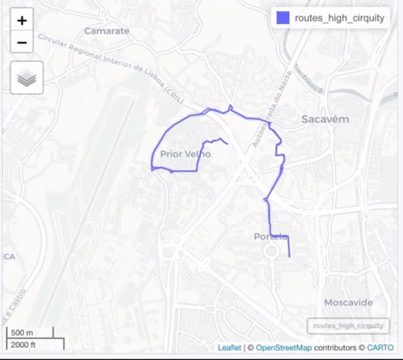
The route w/ cirquity >3

Slide 6
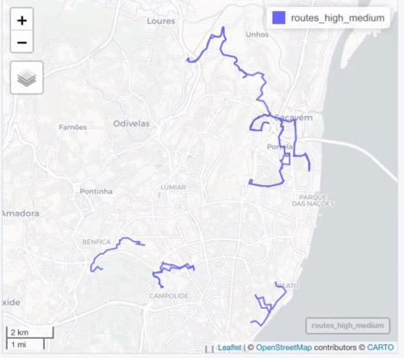
The route w/ cirquity >2

Slide 7
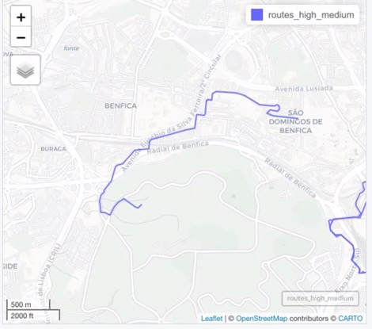
The route w/ cirquity >2: detail on “Radial de Benfica”

Slide 8
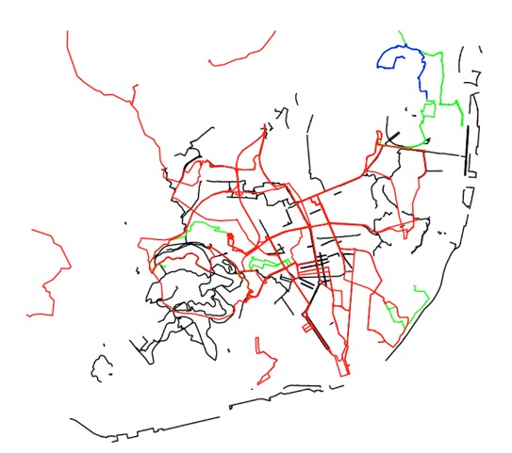
What is missing for cirquity over 2 (green) and 3 (red)

Slide 9
Code by Robin Lovelace & friends (kinda)
library(sf) library(dplyr)
# piggyback::pb_list()
# piggyback::pb_download_url("routes_fast.geojson")
u_routes = "https://github.com/U-Shift/cyclingpotential-hack/releases/download/2.0.0/routes_fast.geojson"
download.file(url = u_routes, destfile = "routes_fast.geojson")
routes_fast = read_sf("routes_fast.geojson")
plot(routes_fast$geometry)
routes_fast_aggregated = routes_fast %>%
group_by(DICOFREor11, DICOFREde11) %>%
summarise( route_distance = sum(distances),
euclidean_distance = first(Length_euclidean),
cirquity = route_distance / euclidean_distance )
summary(routes_fast_aggregated$cirquity)
plot(routes_fast_aggregated)
routes_high_cirquity = routes_fast_aggregated %>%
filter(cirquity > 3) nrow(routes_high_cirquity)
mapview::mapview(routes_high_cirquity)
routes_high_medium = routes_fast_aggregated %>%
filter(cirquity > 2) nrow(routes_high_medium)

Slide 10
Missing link in cycling networks
Methodology:
Missing links for latent demand
Estimate the potential for latent demand
Calculate the entropy index of statistical unit zones (more entropy => higher potential latent demand)
Calibrate a gravity-based OD matrix where a cycling impedance function should exist to balance the interaction potential (mass = entropy index) between OD (out of PCT)
Get routes (fast or other from PCT) to satisfying existing OD pair interaction potential
Calculate equivalent euclidean_distance
Calculate the Cirquity (=route_distance/euclidean_distance)
Overlap with existing cycling Network
If cirquity <2 (for example) => identify missing links on the existing road network
If cirquity >2 (for example) => identify missing links that require fixing the road network (new bridge, under pass, etc.)
Sense of urgency / priority for expanding the cycling network: latent demand
Straightforward suggestion?
Assign interaction potential indicator to each link (problem? Requires development of PCT?)
Color scale for urgency based on demand indicator

